Slide 1

Notes:
“What do you notice, what do you wonder?”
Ask them – “Share with your partner/group what you notice and wonder.”
After they’ve discussed with partner/group, have them share with the whole class.
Accept all their notice/wonder comments.
Make a chart on the board with three columns, labeled “Too Low”/”Just right”/”Too High”
“In your pair/group, decide how many lines there are? What’s an answer that’s too low? Too high?
Record answers suggested by each pair/group.
“What’s a ‘just right’ estimate based on these too low/too high boundaries?” Record their estimates, allowing students to adjust their estimate boundaries or estimate as they entertain the input from other groups.

Slide 2
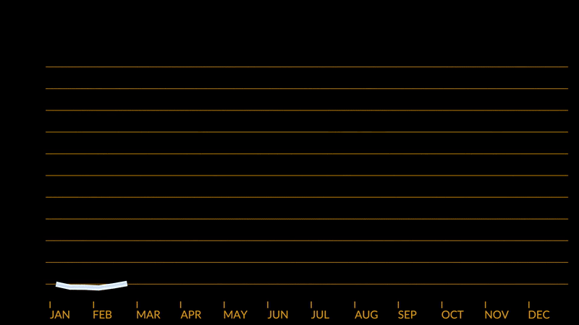
Notes:
“what’s different in this video?
“What’s new?”
They should notice the horizontal lines and the months at the bottom. If students think the original lines have changed, elicit a discussion from other students – do you agree that the white/blue lines have changed? (They haven’t!)
“How does the new information change what you know about all those lines?”
(The added information of the months should lead them to understand that each line is one year)
Using the horizontal orange lines:
“What can you tell me about the ‘journey’ of each line?”
“What patterns do you see?”
“What can you tell me about the start and end of each individual line?”
Without referring directly to the data you collected in the too low/too high chart in Step 1 ask:
“If each line represents a year, and without counting them, how many years do you think this data covers?”
“What’s an answer that’s too low? Too high? Do you want to adjust any of your estimates?

Slide 3
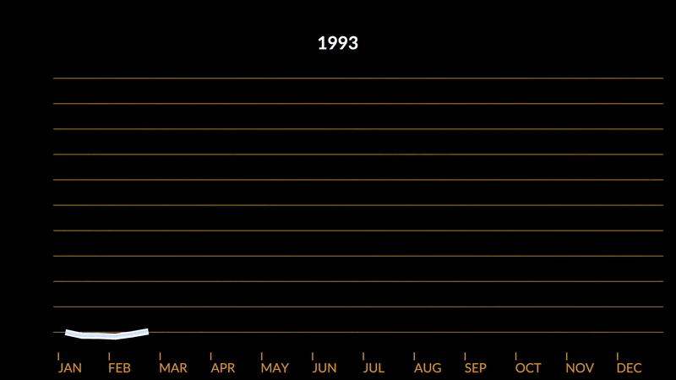
Notes:
They should notice that the years for each line are now running at the top. Before you play it again, with the “2023” final year at the top, return to the data gathered estimating the number of lines in Steps 1 & 2 ask:
“What’s the first year this data was collected?”
Give students time to work in pairs/groups to determine their estimate for the start year. Record their solutions, adding a “Start Year” column to the chart. Ask them to justify their estimates – “how did you get this?”Once all estimates are recorded, play again, asking, “Notice the first year – pay attention!" (play it again if necessary!)
Record the “Start Date” and “End Date” on the board. Ask the class, “Can we confirm the number of lines now that we have this information?”

Slide 4
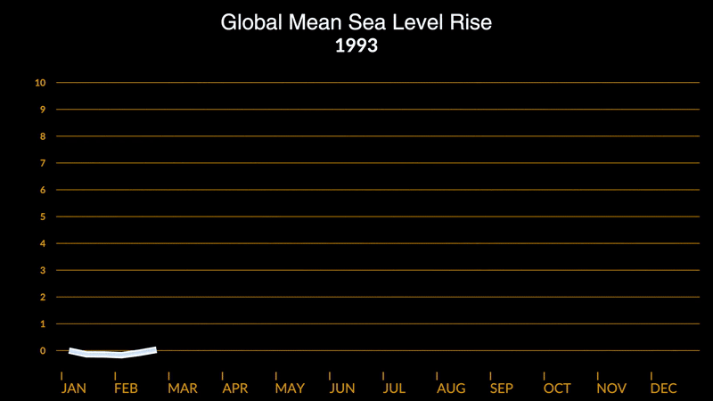
Notes:
“What’s new now?”
They should notice the numbers on the vertical axis, along with the title of the graph.
Based on the title, what do these numbers on the vertical axis represent?
What’s a reasonable unit? Review units that measure length, if necessary!

Slide 5
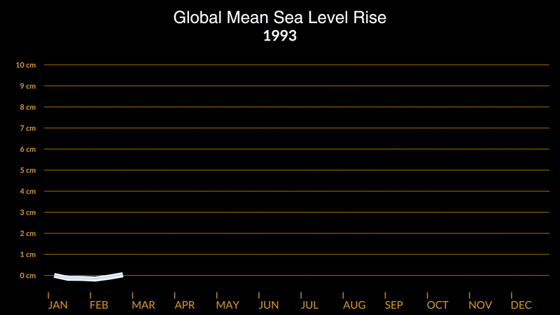

Slide 6
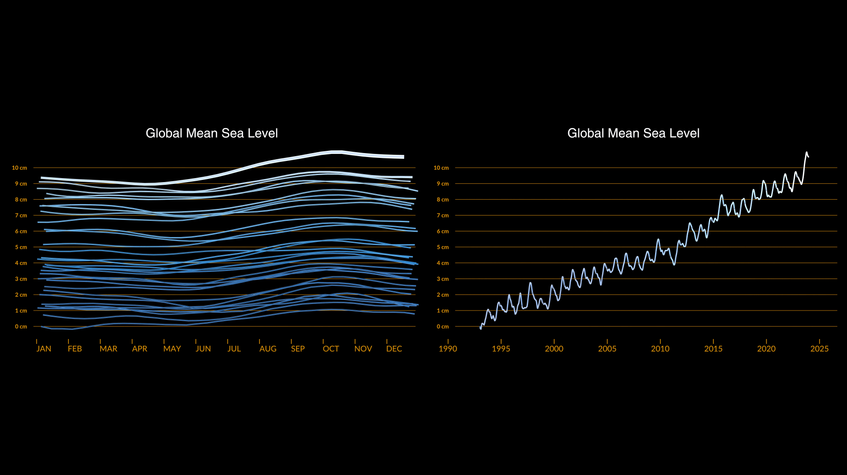
Notes:
“First, were we right about the units?”
“Yikes! What happened at the end?”
Before you play it again, have students discuss with pairs/groups and then share out what they saw happen in the graph at the end. Record their descriptions about what they see at the end and how it’s related to the prior screens. Play the video several times (or as many times as you think are needed) to support their theories of what they saw the first time.

